Slide 1

Assignment 1: Serverless Computing
Prof. Venkatesh Prasad
TA’s: Murali Krishna, Nidhi Bharatiya

Slide 2
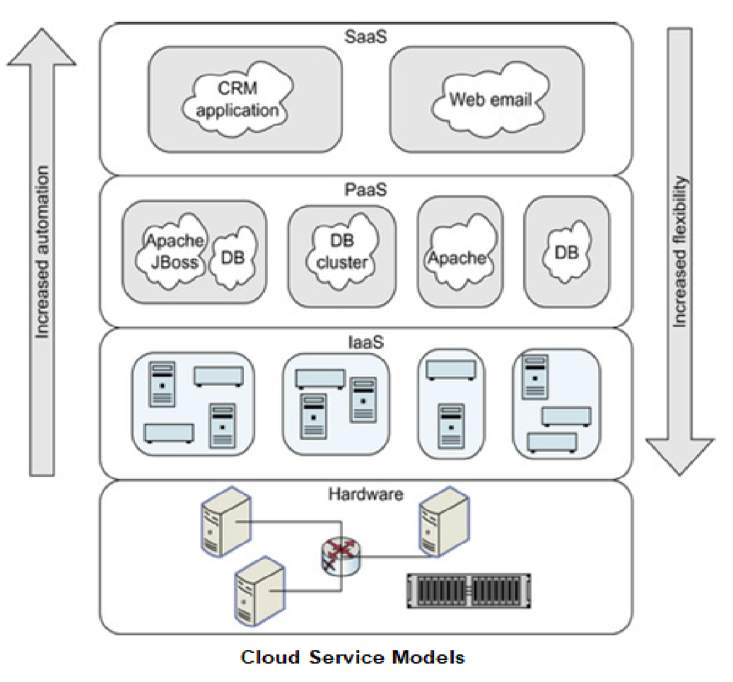
CLOUD COMPUTING
Basic Cloud Computing Service Models
Infrastructure as a service (IaaS)
The physical hardware (servers, disks, and networks) is abstracted into virtual resources and allocated.
Platform as a service (PaaS)
Provides a platform built on top of the abstracted hardware
Commands provided allow allocation of middleware servers (e.g., a database of a certain size), configure and load data into the middleware. You can think of it as a provided runtime env.
Software as a service (SaaS)
Provides the complete application (or solution) as a service.

Slide 3
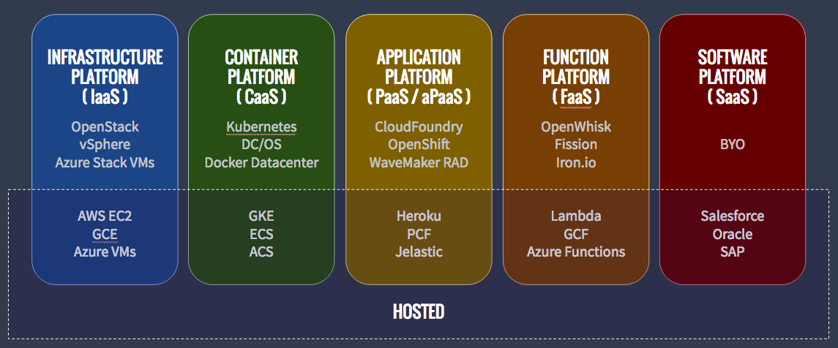
CLOUD COMPUTING
Other Cloud Computing Service Models
There are other service models too, each with varying levels of abstraction! Some important ones are:
CaaS (Container as a Service)
A form of container-based virtualization. Container engines, orchestration and the underlying compute resources are delivered to users as a service from a cloud provider.
E.g. Google Container Engine (GKE), AWS (ECS), Azure (ACS)
HaaS (Hardware as a Service)
Computing power is leased from a central provider. If you look at an EC2 instance, you will see the HaaS being mentioned there.
Eg. EC2 is also a HaaS from a cloud provider.
FaaS (Function as a Service)
Provides a platform allowing customers to develop, run, and manage application functionalities without the complexity of building and maintaining the infrastructure.
E.g. AWS (Lambda), Google Cloud Function

Slide 4
Serverless Computing/Function as a Service
The user is abstracted further from any infrastructure requirement, although the servers still exist on the cloud service provider’s (eg: AWS) side. It is ‘serverless’ in the sense that it is no longer the user/developer’s responsibility to manage a server.
You can deploy and run code/web application or a function without provisioning, managing or configuring the infrastructure. Simply write and upload the code or container image and you are done.
The cloud service provider executes the program on behalf of the user and manages the servers.

Slide 5
Serverless Computing/Function as a Service (Cont.)
Serverless is typically a ‘pay as you go’ model; meaning that the user incurs lesser costs than if they were to provision resources up front!
Users can optimize code execution time and performance with the right function memory size.
Typically used with microservices where each microservice is a separate FaaS function.
Autoscales automatically by spinning up more instances of the program as demand increases.
No resources are allocated when the program is not in use. (Think: can this lead to a ‘cold start’ problem?)

Slide 6
AWS Lambda
Serverless computing offered by AWS
Users create self-contained applications (“functions”) in any of the supported languages and provide it as a zip file, create their own from scratch, or use container images.
AWS will take care of execution and server management (for a fee, of course.)
Users can serve web pages, process data streams, perform calculations, or even integrate lambda with other AWS services.
Each lambda function is run as a container, which is allocated RAM and CPUs at initialization. (You will learn more about containers soon!)
Users are charged based on this allocation multiplied by the time the function runs for.

Slide 7
References
https://en.wikipedia.org/wiki/Serverless_computing
https://en.wikipedia.org/wiki/Serverless_Framework
https://aws.amazon.com/lambda/
https://www.serverless.com/aws-lambda/
https://www.cloudflare.com/en-in/learning/serverless/glossary/serverless-vs-paas/
https://www.cloudflare.com/learning/serverless/glossary/platform-as-a-service-paas/
https://docs.aws.amazon.com/elasticbeanstalk/latest/dg/environments-cfg-autoscaling-triggers.html
https://docs.aws.amazon.com/elasticbeanstalk/latest/dg/using-features.managing.as.html
https://docs.microsoft.com/en-us/azure/architecture/best-practices/auto-scaling

Slide 8
Thank you

